Slide 1
ECE 313: PROBABILITY WITH ENGINEERING APPLICATIONS
Fall 2023
Prof. Eric Chitambar
Lecture 18

Slide 2







The Exponential Distribution

Slide 3
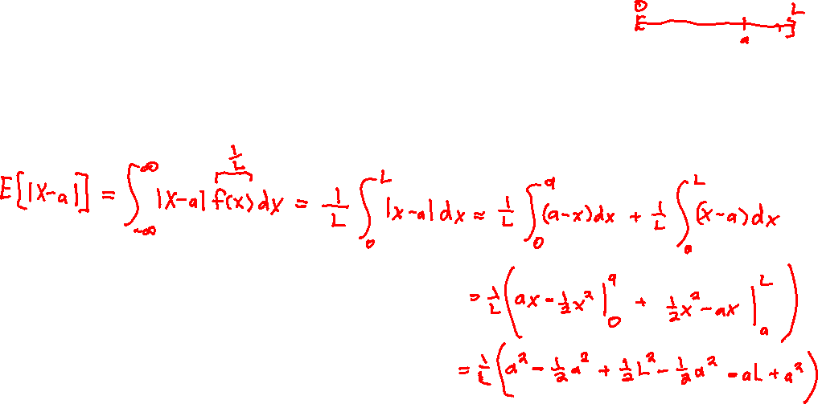
The Uniform and Exponential Distribution

Slide 4
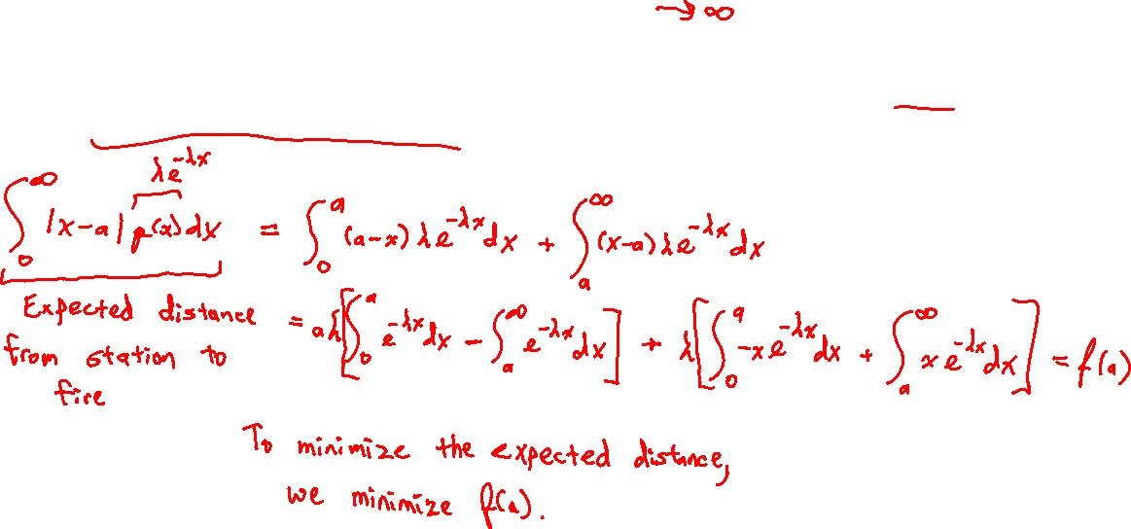
The Uniform and Exponential Distribution

Slide 5



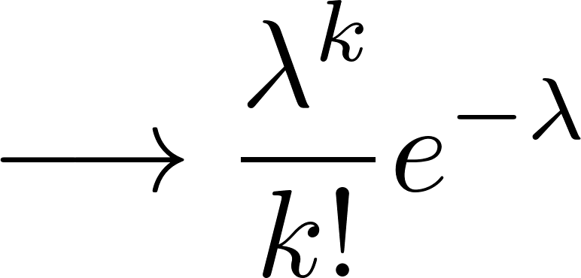
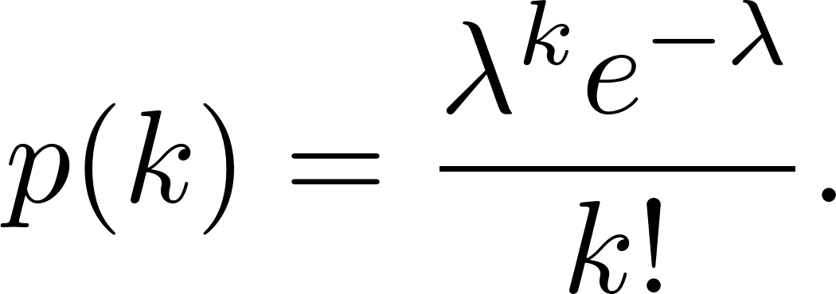


Poisson Distribution

Slide 6



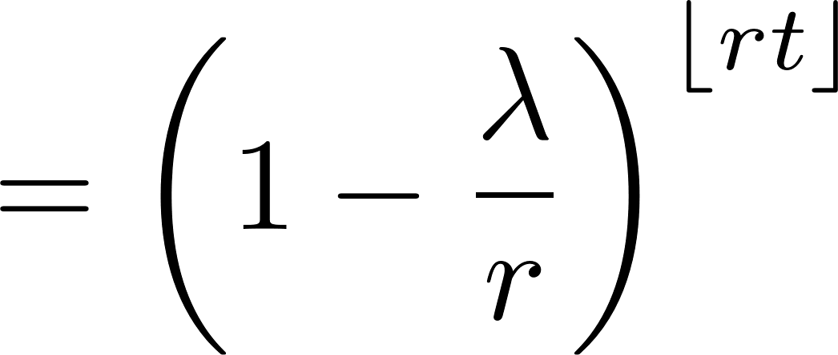





Exponential Distribution

Slide 7
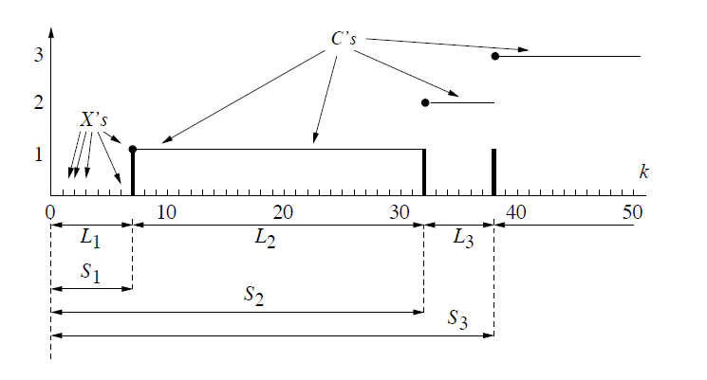


Bernoulli Processes

Slide 8





Bernoulli Process → Poisson Process

Slide 9



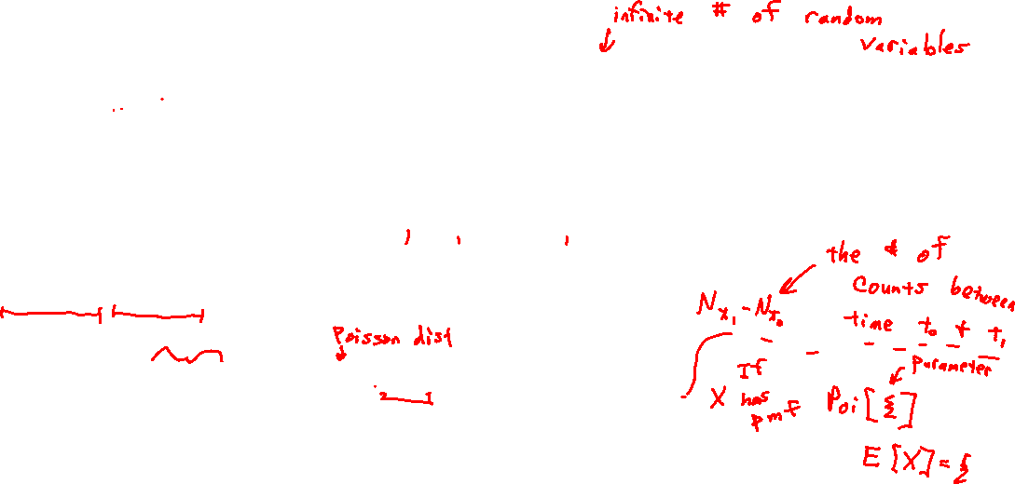
A Poisson Process

Slide 10



A Poisson Process

Slide 11


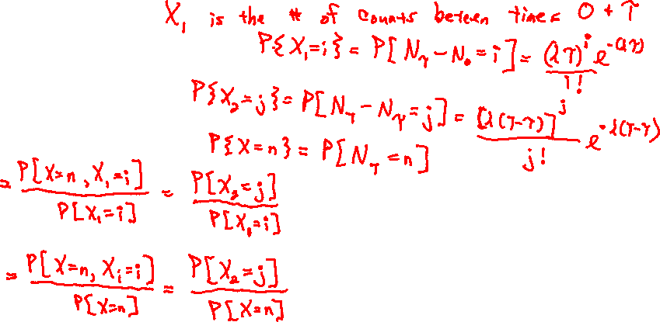
A Poisson Process

Slide 12
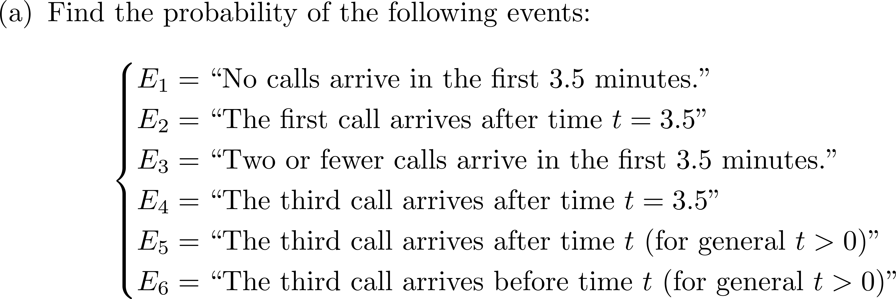
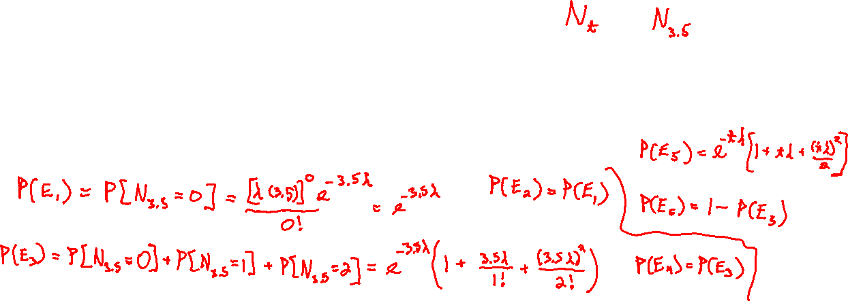
A Poisson Process

Slide 13
A Poisson Process

Slide 14
The Erlang Distribution

